Slide 1

A+ Guide to Managing and Maintaining Your PC, 7e
Chapter 1
Introducing Hardware

Slide 2
Objectives
Learn that a computer requires both hardware and software to work
Learn about the many different hardware components inside of and connected to a computer
A+ Guide to Managing and Maintaining Your PC, 7e

Slide 3
Hardware Needs Software to Work
Hardware
  Computer’s physical components
    Monitor, keyboard, memory, hard drive
Software
  Instruction set
    Directs hardware to accomplish a task
  Uses hardware for four basic functions
    Input, processing, storage, output
Hardware components
  Require an electrical system
A+ Guide to Managing and Maintaining Your PC, 7e

Slide 4
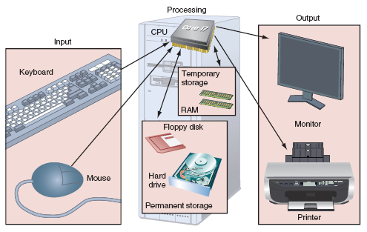
Figure 1-1 Computer activity consists of input, processing, storage, and output
Courtesy: Course Technology/Cengage Learning
A+ Guide to Managing and Maintaining Your PC, 7e

Slide 5
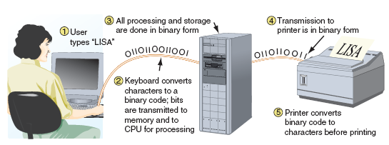
Hardware Needs Software to Work (cont’d.)
User interaction with computer
  User and software communicate with input device
  Hardware uses two states: on and off
Figure 1-2 All communication, storage, and processing of data inside a computer are in binary form until presented as output to the user
Courtesy: Course Technology/Cengage Learning
A+ Guide to Managing and Maintaining Your PC, 7e
Notes:
IMPORTANT

Slide 6
Hardware Needs Software to Work (cont’d.)
Binary number system
  Stores and reads two states
    Zero or one
  Bit: binary digit
    Value of zero or one
  Nibble: four bits
  Byte: eight bits
  Used for counting, calculation, storage operations
American Standard Code for Information Interchange (ASCII)
  Used for storing information
A+ Guide to Managing and Maintaining Your PC, 7e

Slide 7
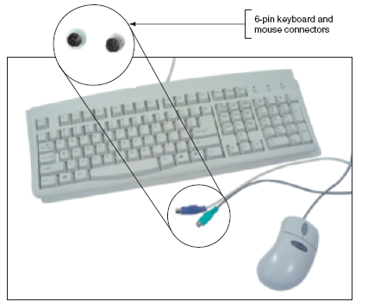
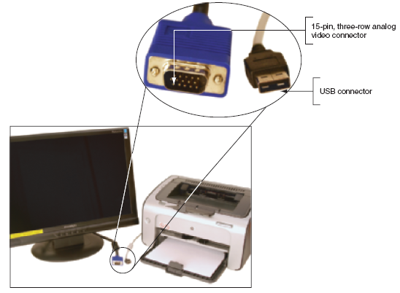
Figure 1-6 The two most popular output devices are the monitor and the printer
Courtesy: Course Technology/Cengage Learning
Figure 1-5 The keyboard and the mouse are the two most popular input devices
Courtesy: Course Technology/Cengage Learning
I/O device communication with computer components: 1. Wireless & 2. Cable (Access point located in back or front of case)
A+ Guide to Managing and Maintaining Your PC, 7e

Slide 8
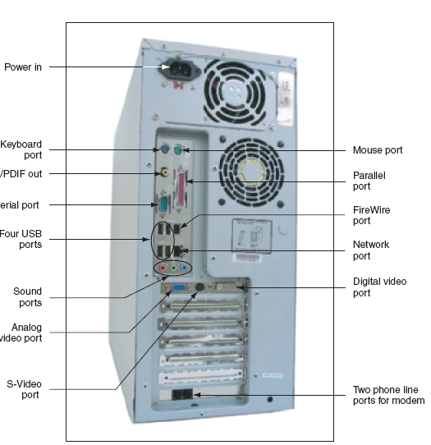
Figure 1-4 Input/output devices connect to the computer case by ports usually found on the back of the case
Courtesy: Course Technology/Cengage Learning
A+ Guide to Managing and Maintaining Your PC, 7e

Slide 9
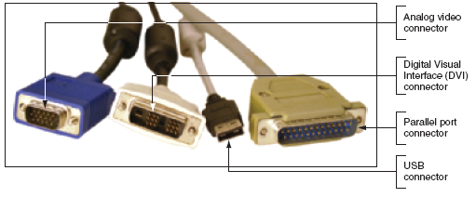
Figure 1-7 Two video connectors and two connectors used by a printer
Courtesy: Course Technology/Cengage Learning
A+ Guide to Managing and Maintaining Your PC, 7e

Slide 10
Hardware Inside the Computer Case
Storage and processing occurs in the case
Internal devices common to most computers
  Motherboard containing CPU, memory, other parts
  Hard drive, optical drive for permanent storage
  Power supply with power cords supplying electricity
  Adapter cards for internal and external communication
  Cables to connect devices
Adapter card installed in expansion slots
Cable types
  Data (communication) and power
A+ Guide to Managing and Maintaining Your PC, 7e

Slide 11
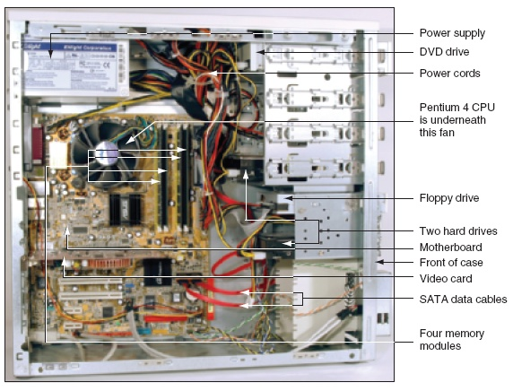
Figure 1-8 Inside the computer case
Courtesy: Course Technology/Cengage Learning
A+ Guide to Managing and Maintaining Your PC, 7e

Slide 12
The Motherboard
Largest, most important circuit board
  Main board or system board
  Contains the CPU, expansion slots, other devices
Motherboard component categories
  Processing, temporary storage, communication, power
All devices communicate with motherboard CPU
Peripheral device links to motherboard via cable
Motherboard ports may be outside of the case
  Keyboard, mouse, parallel, USB ports, sound ports
A+ Guide to Managing and Maintaining Your PC, 7e

Slide 13
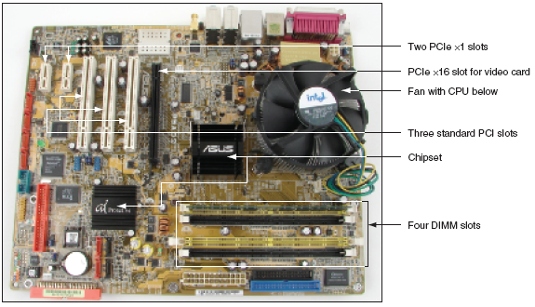
Figure 1-9 All hardware components are either located on the motherboard or directly or indirectly connected to it because they must all communicate with the CPU
Courtesy: Course Technology/Cengage Learning
A+ Guide to Managing and Maintaining Your PC, 7e

Slide 14
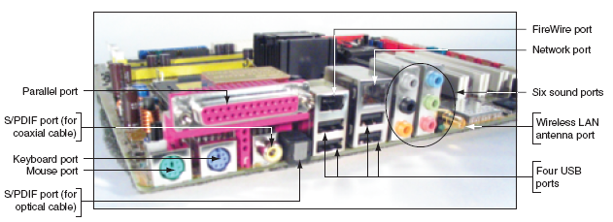
Figure 1-10 A motherboard provides ports for common I/O devices
Courtesy: Course Technology/Cengage Learning
A+ Guide to Managing and Maintaining Your PC, 7e

Slide 15
Storage Devices
Primary storage (main memory)
  Temporary storage used by the processor
Secondary storage (permanent storage)
  Enables data to persist after machine turned off
  Examples: hard drive, CD, DVD, USB drive
Primary-secondary memory relationship analogy
  Library book stacks: permanent storage
  Books moved to a desk: temporary storage
A+ Guide to Managing and Maintaining Your PC, 7e

Slide 16
Primary Storage
Provided by random access memory (RAM)
  Located on motherboard, adapter cards
RAM chips
  Plugs into motherboard
  Most common: dual inline memory module (DIMM)
  Video memory: embedded on video card
Volatile memory: temporary (lost when computer turns off)
Non-volatile memory: permanent
A+ Guide to Managing and Maintaining Your PC, 7e

Slide 17
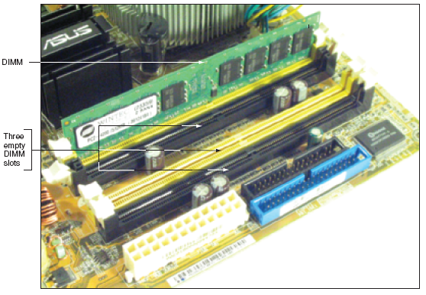
Figure 1-13 A DIMM holds RAM and is mounted directly on a motherboard
Courtesy: Course Technology/Cengage Learning
A+ Guide to Managing and Maintaining Your PC, 7e

Slide 18
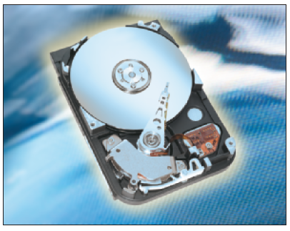
Secondary Storage
Remote storage locations containing data and instructions
  Cannot be directly processed by CPU
  Permanent
Hard drives
  Main secondary computer storage device
A+ Guide to Managing and Maintaining Your PC, 7e

Slide 19
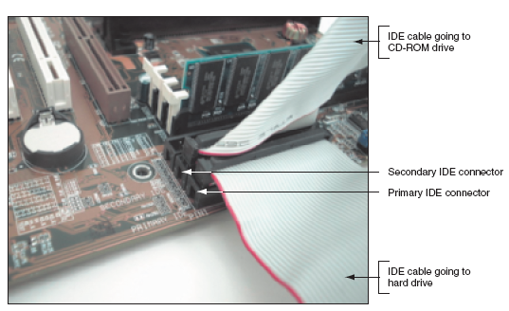
Figure 1-18 Using a parallel ATA interface, a motherboard has two IDE connectors, each of which can accommodate two devices; a hard drive usually connects to the motherboard using the primary IDE connector
Courtesy: Course Technology/Cengage Learning
A+ Guide to Managing and Maintaining Your PC, 7e

Slide 20
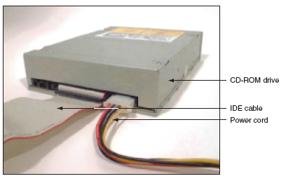
Secondary Storage (cont’d.)
Optical drives
  RW can write to a disk
  ROM (read-only memory) can only read a disc
Figure 1-22 This CD drive is an EIDE device and connects to the motherboard by way of an IDE data cable
Courtesy: Course Technology/Cengage Learning
A+ Guide to Managing and Maintaining Your PC, 7e

Slide 21
R vs. RW (Read vs. Read/Write)
Hard disks can of course both read and write data (which isn't true of all storage devices.)
After the dash or plus sign comes “R” or “RW.” CDs or DVDs with an R can be written to one time then the disc becomes a CD-ROM or DVD-ROM with permanent, inerasable content. CD-RW and DVD-RW (R=read; W=write) discs can be written to multiple times as your files are updated, edited and changed.
A+ Guide to Managing and Maintaining Your PC, 7e

Slide 22
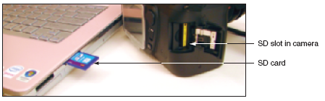
Secondary Storage (cont’d.)
USB flash drives and memory cards
  Popular, nonvolatile flash memory chips
  Compact; easy to use; currently hold up to 64 GB of data
Figure 1-24 Most laptops have a memory card slot that can accommodate an SD card
Courtesy: Course Technology/Cengage Learning
A+ Guide to Managing and Maintaining Your PC, 7e

Slide 23
Secondary Storage (cont’d.)
Floppy drive
  Older secondary storage device
  3.5-inch disk holding 1.44 MB of data
A+ Guide to Managing and Maintaining Your PC, 7e

Slide 24
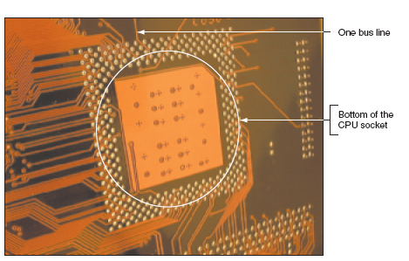
Motherboard Components Used For Communication Among Devices
Bus
  System of pathways, transmission protocols
  Carries the data
Figure 1-27 On the bottom of the motherboard, you can see bus lines terminating at the CPU socket
A+ Guide to Managing and Maintaining Your PC, 7e

Slide 25
Motherboard Components Used For Communication Among Devices (cont’d.)
Data path size
  Width of a data bus
Data bus sizes today
  16, 32, 64, 128, 256 bits wide
Motherboard can have more than one bus
  Main motherboard bus
    Communicates with CPU, memory, chipset
    Also called system bus, front side bus (FSB), memory bus, host bus, local bus, external bus
A+ Guide to Managing and Maintaining Your PC, 7e

Slide 26
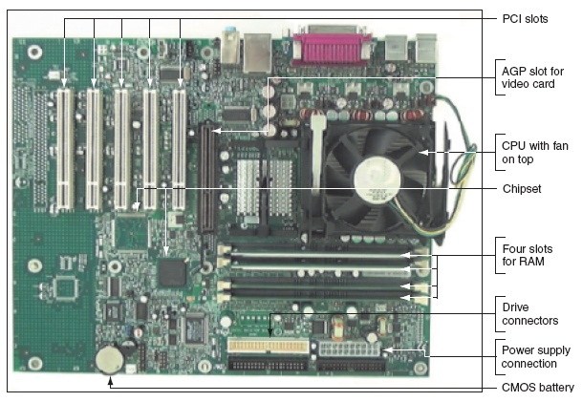
Figure 1-31 The one AGP slot used for a video card is set farther from the edge of the board than the PCI slots
Courtesy: Course Technology/Cengage Learning
A+ Guide to Managing and Maintaining Your PC, 7e

Slide 27
Expansion Cards
Cards that connect the CPU to an external device
  Video: provides a port for the monitor
  Sound: provides ports for speakers and microphones
  Network: provides a port for a network cable
  Modem: provides ports for phone lines
Determine a card’s function by identifying its port
A+ Guide to Managing and Maintaining Your PC, 7e

Slide 28
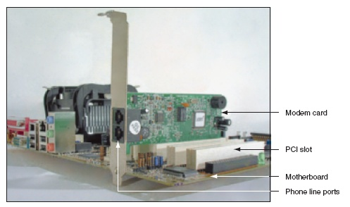
Figure 1-32 This adapter card is a modem card and is
mounted in a PCI slot on the motherboard
Courtesy: Course Technology/Cengage Learning
A+ Guide to Managing and Maintaining Your PC, 7e

Slide 29
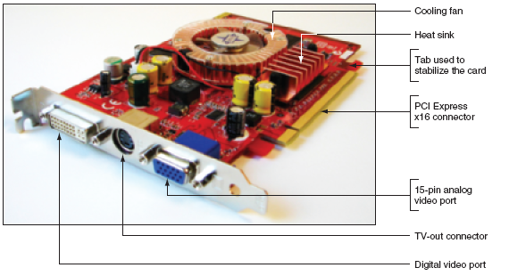
Figure 1-34 The easiest way to identify this video card is to look at the ports on the end of the card
Courtesy: Course Technology/Cengage Learning
A+ Guide to Managing and Maintaining Your PC, 7e

Slide 30
The Electrical System
Power supply
  Most important electrical component
  Converts AC voltage external source to DC voltage
  Reduces voltage from 110-120 volts to 12 volts or less
  Runs a fan to cool the inside of the computer case
Temperatures > 185° F can cause component failure
Motherboard has 1 or 2 connections to power supply
A+ Guide to Managing and Maintaining Your PC, 7e

Slide 31
Summary
A computer comprises hardware and software
Main functions
  Input, output, processing, storage
Data stored in a binary format (one or zero, on or off)
Input/output devices
  Keyboard, mouse, printer, monitor
Motherboard (system board)
  Contains CPU. Main Board
A+ Guide to Managing and Maintaining Your PC, 7e

Slide 32
Summary (cont’d.)
Primary storage (RAM):volatile (gone when turned off)
Secondary storage: nonvolatile
Computer bus
  System of communication pathways
Expansion cards
  Cards that connect the CPU to an external device
A+ Guide to Managing and Maintaining Your PC, 7e

Slide 33
CHAPTER 1: VOCABULARY
Hardware
Software
Binary number system
CPU
Port
Input/output
Hard drive
Motherboard
Chipset
Primary storage
Secondary storage
RAM
DIMM
Bus
A+ Guide to Managing and Maintaining Your PC, 7e

